Slide 1

Intelligent Ayurvedic Medicine System for Arthritis
AyuAIra
22_23-J-73

Slide 2
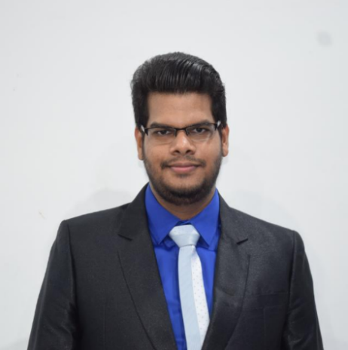
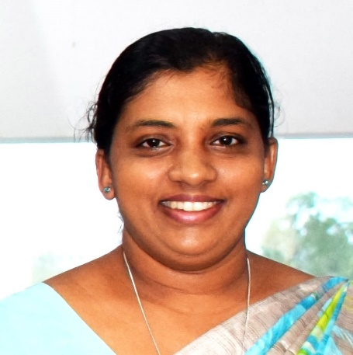
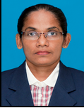
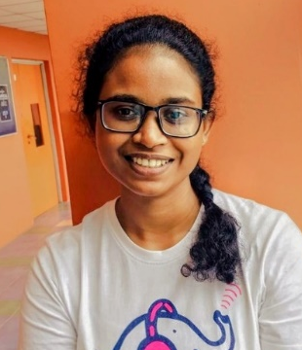
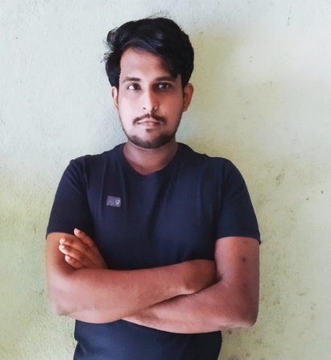
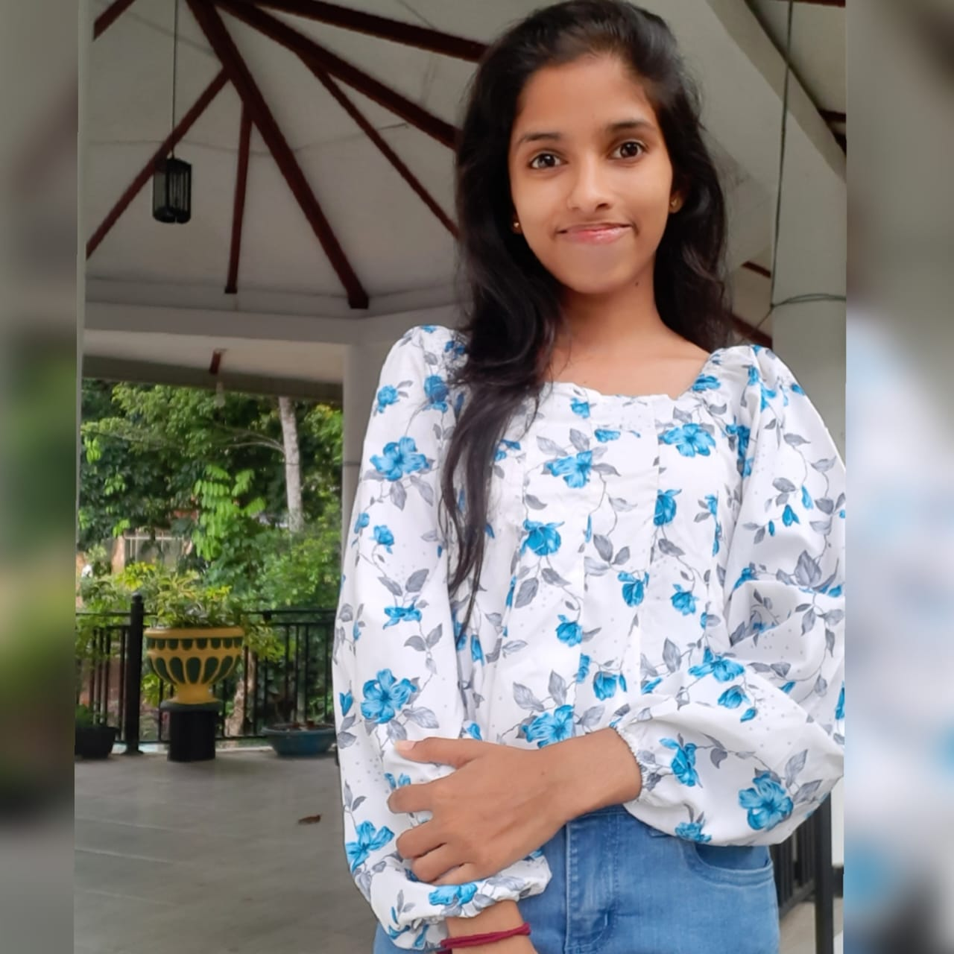
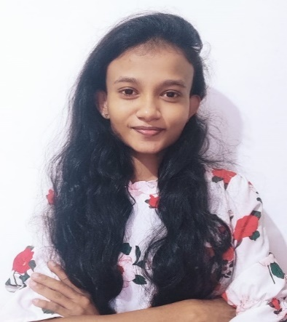
Team Members
External Supervisor
Dr.K.G.C.Dissanayake
Senior Lecturer
Gampaha Wickramarachchi Ayurveda Institute
Supervisor
Mr Ravi Supunya
Co-Supervisor
Ms Suriyaa Kumari
Hewapathirana L.L
IT19025322
Mallawaarachchi T.S
IT19955582
Samaranayaka S.W
IT19955414
Jayangika D.H.K.C
IT19146270

Slide 3
Introduction
The aim of this research is to develop an intelligent Ayurvedic medicine system for the early detection and effective management of arthritis.
The proposed system consists of four components,
X-Ray Image Analysis
Blood Report Monitoring
Ayurvedic Treatment Recommendation
Continuous Monitoring and Feedback.
The proposed system integrates advanced technology with traditional knowledge of Ayurvedic machine to provide a comprehensive solution for the early detection and effective management of arthritis.

Slide 4

Research Problem
How the Advanced technology and Ayurvedic medicine can be combined to provide a comprehensive solution for early detection and effective management of arthritis?

Slide 5

Main Objective
The aim of this research is to develop an intelligent Ayurvedic medicine system for the early detection and effective management of arthritis.

Slide 6
Sub Objective

Slide 7
Overall System Diagram

Slide 8

X-Ray Image Analysis
Hewapathirana L.L | IT19025322
B.Sc. (Hons) Degree in Information Technology Specialization in Information Technology

Slide 9
Introduction
Arthritis is a common ailment that affects millions of people worldwide, and Ayurvedic medicine has been used for centuries to treat this condition. However, accurately diagnosing and assessing the severity of arthritis can be challenging, especially when relying on human analysis of X-ray images.
Machine learning algorithms can help automate the analysis of X-ray images to accurately detect signs of arthritis and assess its severity in accordance with Ayurvedic principles.
This technology has the potential to revolutionize arthritis diagnosis and treatment, improving patient outcomes and quality of life.
IT19025322 | Hewapathirana L.L | Project ID : 22_23-J-73

Slide 10
Research Question
How can X-Ray images be analyzed using machine learning algorithms to accurately detect signs of arthritis and assess its severity?
IT19025322 | Hewapathirana L.L | Project ID : 22_23-J-73

Slide 11
Main and Sub Objective
Main Objective
To analyze X-Ray images to detect signs of arthritis and assess the severity of the condition.
Sub Objective
Identify relevant X-Ray Images datasets
To analyze X-Ray images to detect signs of arthritis
Assess the severity of arthritis based on the detected signs
IT19025322 | Hewapathirana L.L | Project ID : 22_23-J-73

Slide 12
Novelty of component
In ayurvedic medicine, symptoms identified by ayurvedic doctors are using machine learning algorithms to automate the process of arthritis detection and severity assessment integrated with x-ray images for the convenience of doctors..
The solution to the novelty is to fill a gap in Ayurveda medicine treatment.
IT19025322 | Hewapathirana L.L | Project ID : 22_23-J-73

Slide 13
Research Gap
Features | Automated Diagnosis of Knee-Joint Diseases using Medical Imaging and Machine Learning: A Systematic Review | An Efficient Method for Classification of Arthritis Using Machine Learning Techniques | A comparison of feature extraction and selection techniques for computer-assisted diagnosis of rheumatoid arthritis using hand radiographs | Classification of arthritis using data mining techniques | AyuAIra (Proposed system)
Focus specifically on Ayurvedic medicine or traditional methods of X-ray image analysis for arthritis patients. | No | No | No | No | Yes
Uses machine learning techniques for classifying arthritis. | Yes | Yes | No | Yes | Yes
Assess the severity of the condition. | No | No | No | No | Yes
IT19025322 | Hewapathirana L.L | Project ID : 22_23-J-73

Slide 14


System Diagram
Methodology
Tools and Technology
03. Requirements
IT19025322 | Hewapathirana L.L | Project ID : 22_23-J-73

Slide 15
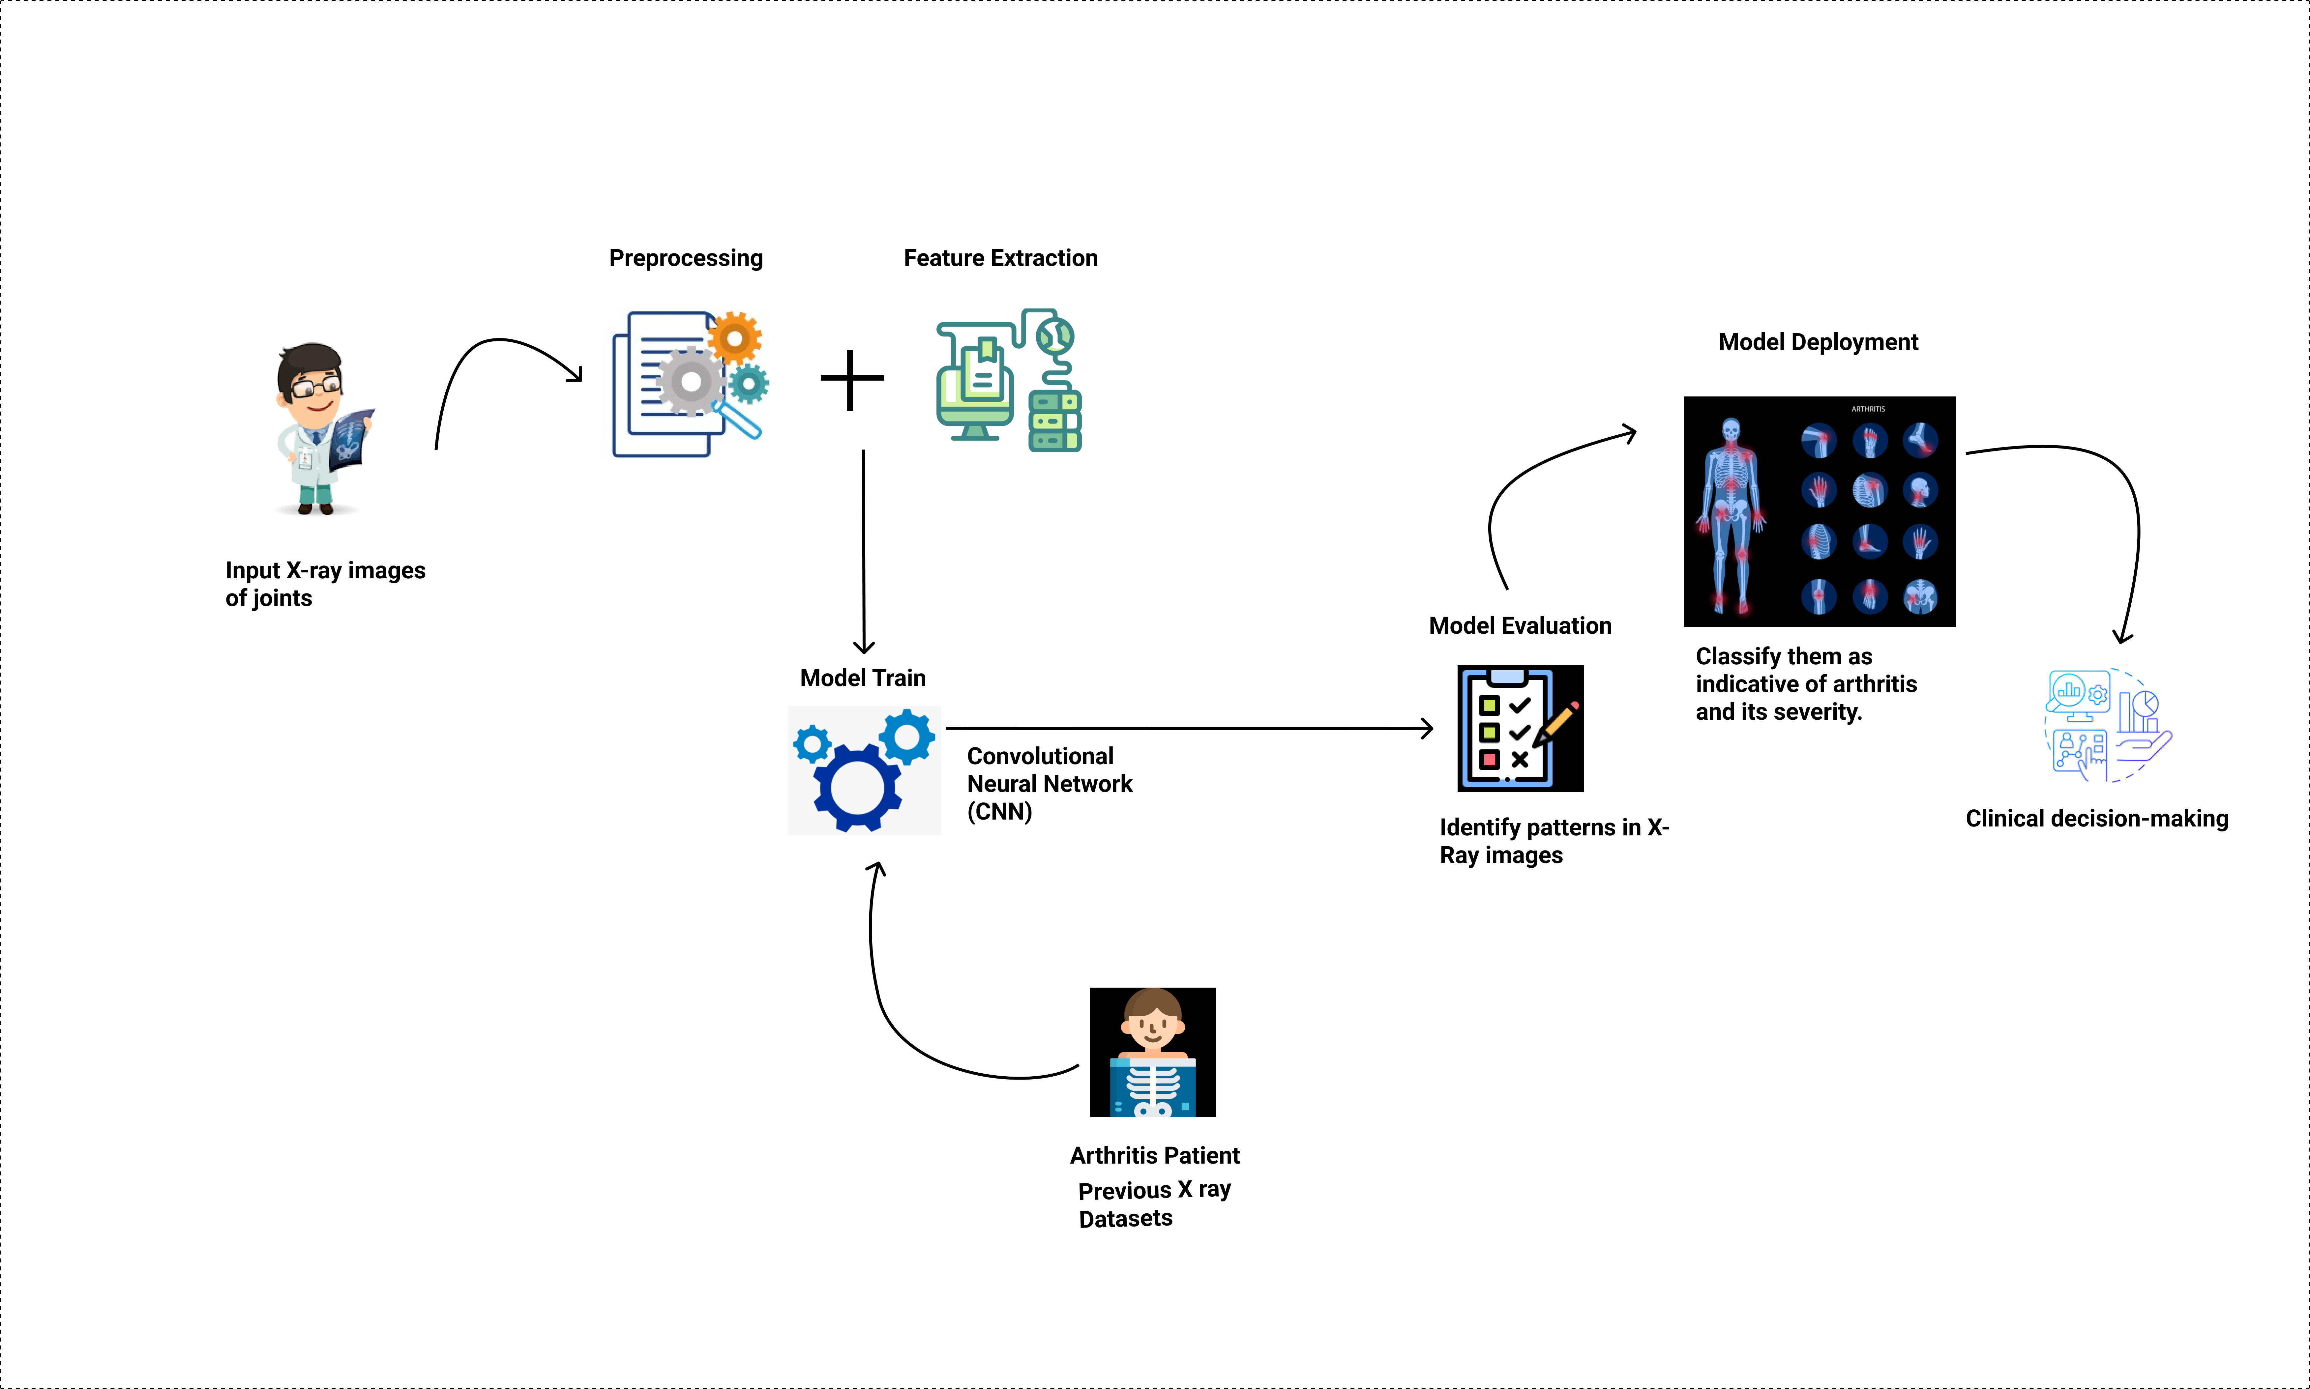
System Diagram
IT19025322 | Hewapathirana L.L | Project ID : 22_23-J-73

Slide 16


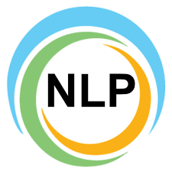

Tools and Technologies
Technologies
Techniques
Node JS
AWS
Google Collabs
React Native
Visual Studio IDE
Firebase,
Heroku
Data Preparation
Data Preprocessing
Segmentation
Feature Extraction
Support vector machines
IT19025322 | Hewapathirana L.L | Project ID : 22_23-J-73

Slide 17
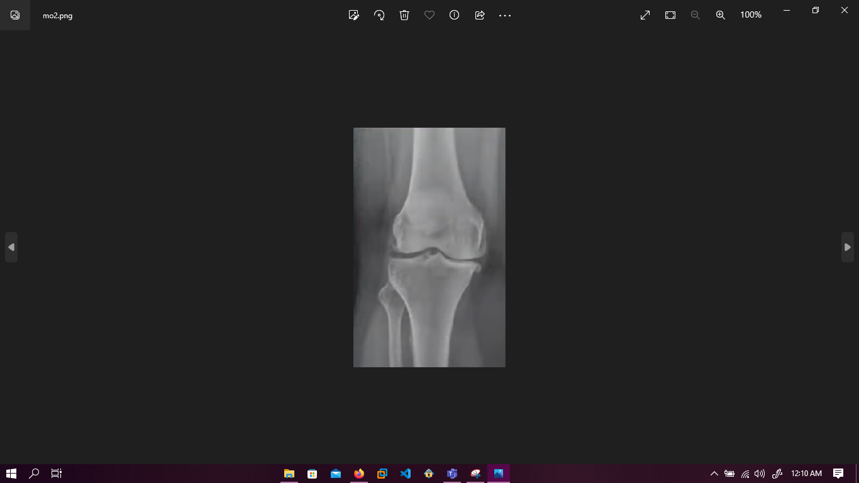
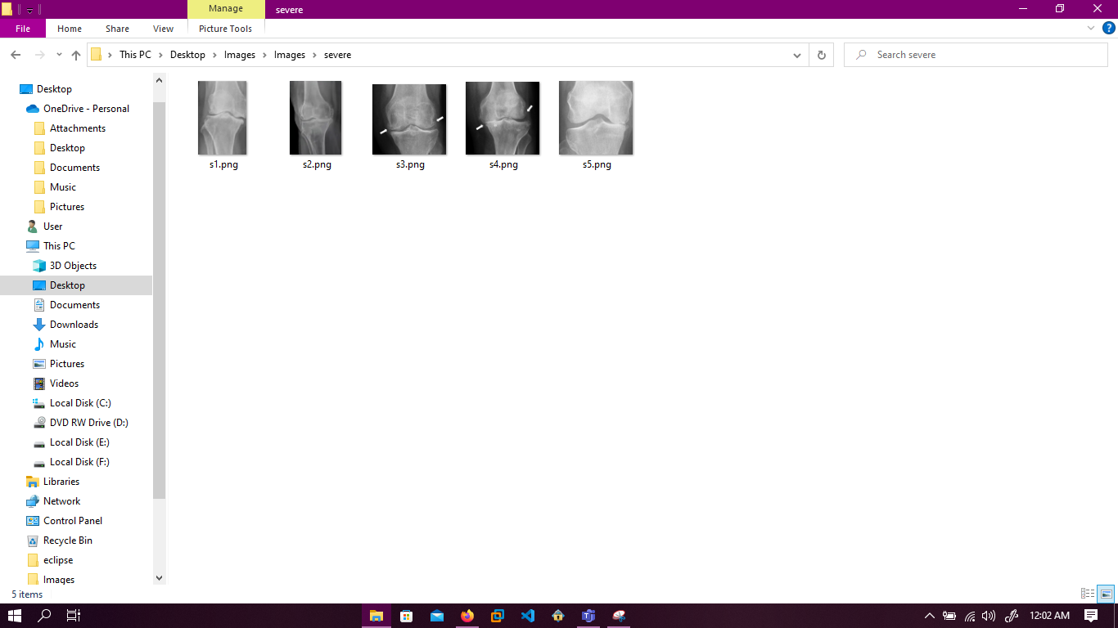
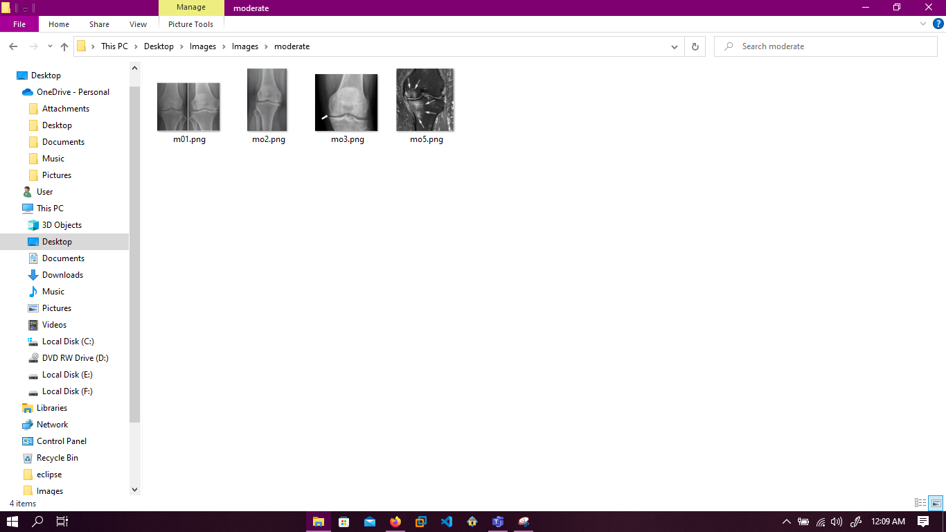
Dataset
Source:
We collected data from the field visit. (Wickramarachchi Ayurvedic University)
IT19025322 | Hewapathirana L.L | Project ID : 22_23-J-73

Slide 18
Current Progress – 50%
Collect real-time datasets of X-Ray Images of arthritis
50%
Assess the severity of the arthritis condition.
Tested the trained model accuracy
IT19025322 | Hewapathirana L.L | Project ID : 22_23-J-73

Slide 19
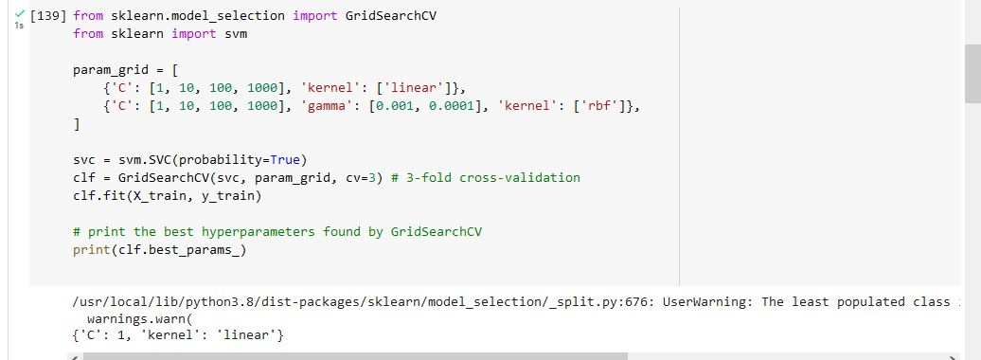
Evidence of the project
Used algorithm : Support Vector Machine (SVM)
IT19025322 | Hewapathirana L.L | Project ID : 22_23-J-73

Slide 20
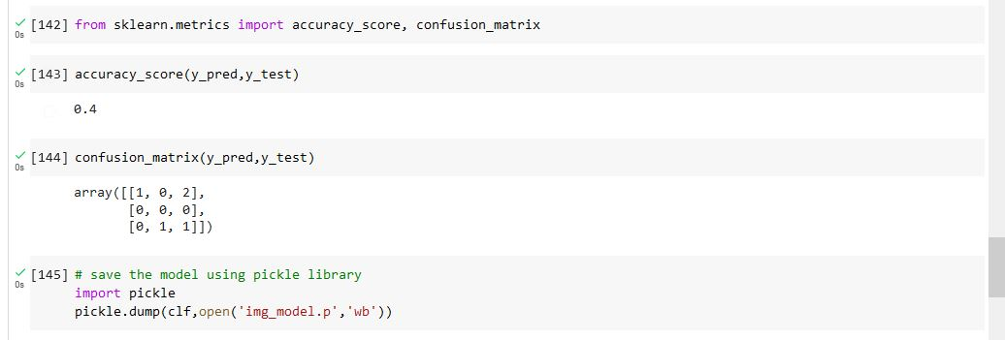
Evidence of the project
IT19025322 | Hewapathirana L.L | Project ID : 22_23-J-73

Slide 21
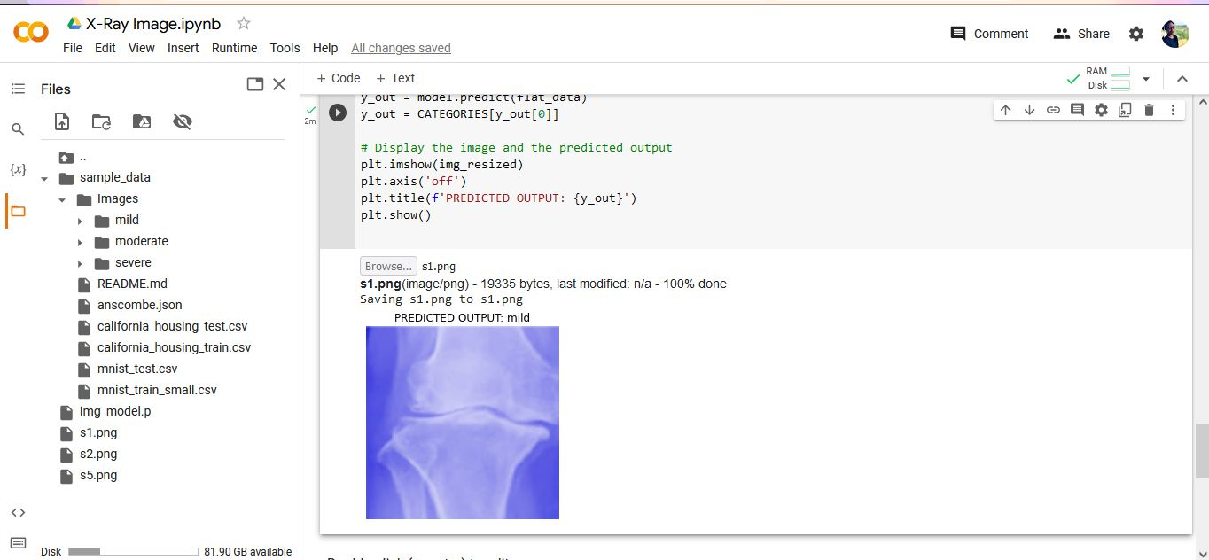
Evidence of the project
IT19025322 | Hewapathirana L.L | Project ID : 22_23-J-73

Slide 22

Next expected Progress – 100%
Improve the accuracy of the x-ray image analysis.
Try to collect more datasets of x-rays to detect sings of arthritis and assess the severity of the condition using Convolutional Neural Network(CNN).
Designing and implementing the application.
IT19025322 | Hewapathirana L.L | Project ID : 22_23-J-73

Slide 23

Blood Report Monitoring
Mallawaarachchi | IT19955582
B.Sc. (Hons) Degree in Information Technology Specialization in Information Technology

Slide 24
Introduction
Arthritis is a disease that affects the joints, causing inflammation and pain. It can be difficult to predict how the disease will progress over time, which makes it challenging for doctors to develop effective treatment plans
Blood tests are essential in monitoring the progression of arthritis and evaluating the effectiveness of treatments.
Manual analysis of blood test results can be time-consuming, error-prone, and may not provide real-time insights into disease progression for doctors .
The application of deep learning algorithms, automate the analysis of blood test results and provide accurate predictions about disease progression and treatment efficacy.
Aims to highlight the potential of using deep learning algorithms to analyze blood test results for the diagnosis, monitoring, and treatment of arthritis.
IT19955582 | Mallawaarachchi T.S | Project ID : 22_23-J-73

Slide 25
Research Problem
How can blood test results be analyzed using deep learning algorithms to track the progression of arthritis and evaluate the effectiveness of treatments?
IT19955582 | Mallawaarachchi T.S | Project ID : 22_23-J-73

Slide 26
Research Gap
Features | Predict Laboratory Test Results | Text Detection and Recognition for Images of Medical Laboratory Reports | Rheumatoid Arthritis Diagnosis | Diagnostic disease prediction based on laboratory tests | Proposed System
Arthritis Lab report data extract and analysis the disease level. | √ | √ | × | √ | √
Specifically for three laboratory report templates, data is analyzed using this component. | × | × | × | × | √
Display the difference in disease levels from month to month using a graph | × | × | × | × | √
Able to predict the Treatment progress using blood report | × | × | × | × | √
IT19955582 | Mallawaarachchi T.S | Project ID : 22_23-J-73

Slide 27
Main and Sub Objectives
Main Objective
To monitor blood test results over time to track the progression of arthritis and the effectiveness of treatments.
Sub Objectives
Identify relevant blood test parameters
Evaluate the effectiveness of treatments
Validate test results with an Ayurvedic traditional approach
IT19955582 | Mallawaarachchi T.S | Project ID : 22_23-J-73

Slide 28
TREATMENT PROGRESSION
Novelty of Component
Using deep learning algorithms to automatically analyze blood test results and make predictions about the Treatment progression of arthritis.
BLOOD REPORT MONITORING
Identify the blood report features
Arthritis Patients Data
Analyze Blood cell count, ESR, CRP, RF, ANA, CCP,
Traditional Knowledge of Ayurvedic
Doctor experience and traditional Knowledge about blood report Analisis
IT19955582 | Mallawaarachchi T.S | Project ID : 22_23-J-73

Slide 29
Methodology
A recurrent neural network (RNN) was suggested to be developed to analyze time-series data of blood test results and predict the progression of arthritis.
As an alternative, a novel methodology that utilizes a Long Short-Term Memory (LSTM) network could be considered.
LSTM networks are particularly well suited for analyzing time-series data and making predictions about future trends.
01.System Diagram
03. Requirements
IT19955582 | Mallawaarachchi T.S | Project ID : 22_23-J-73

Slide 30
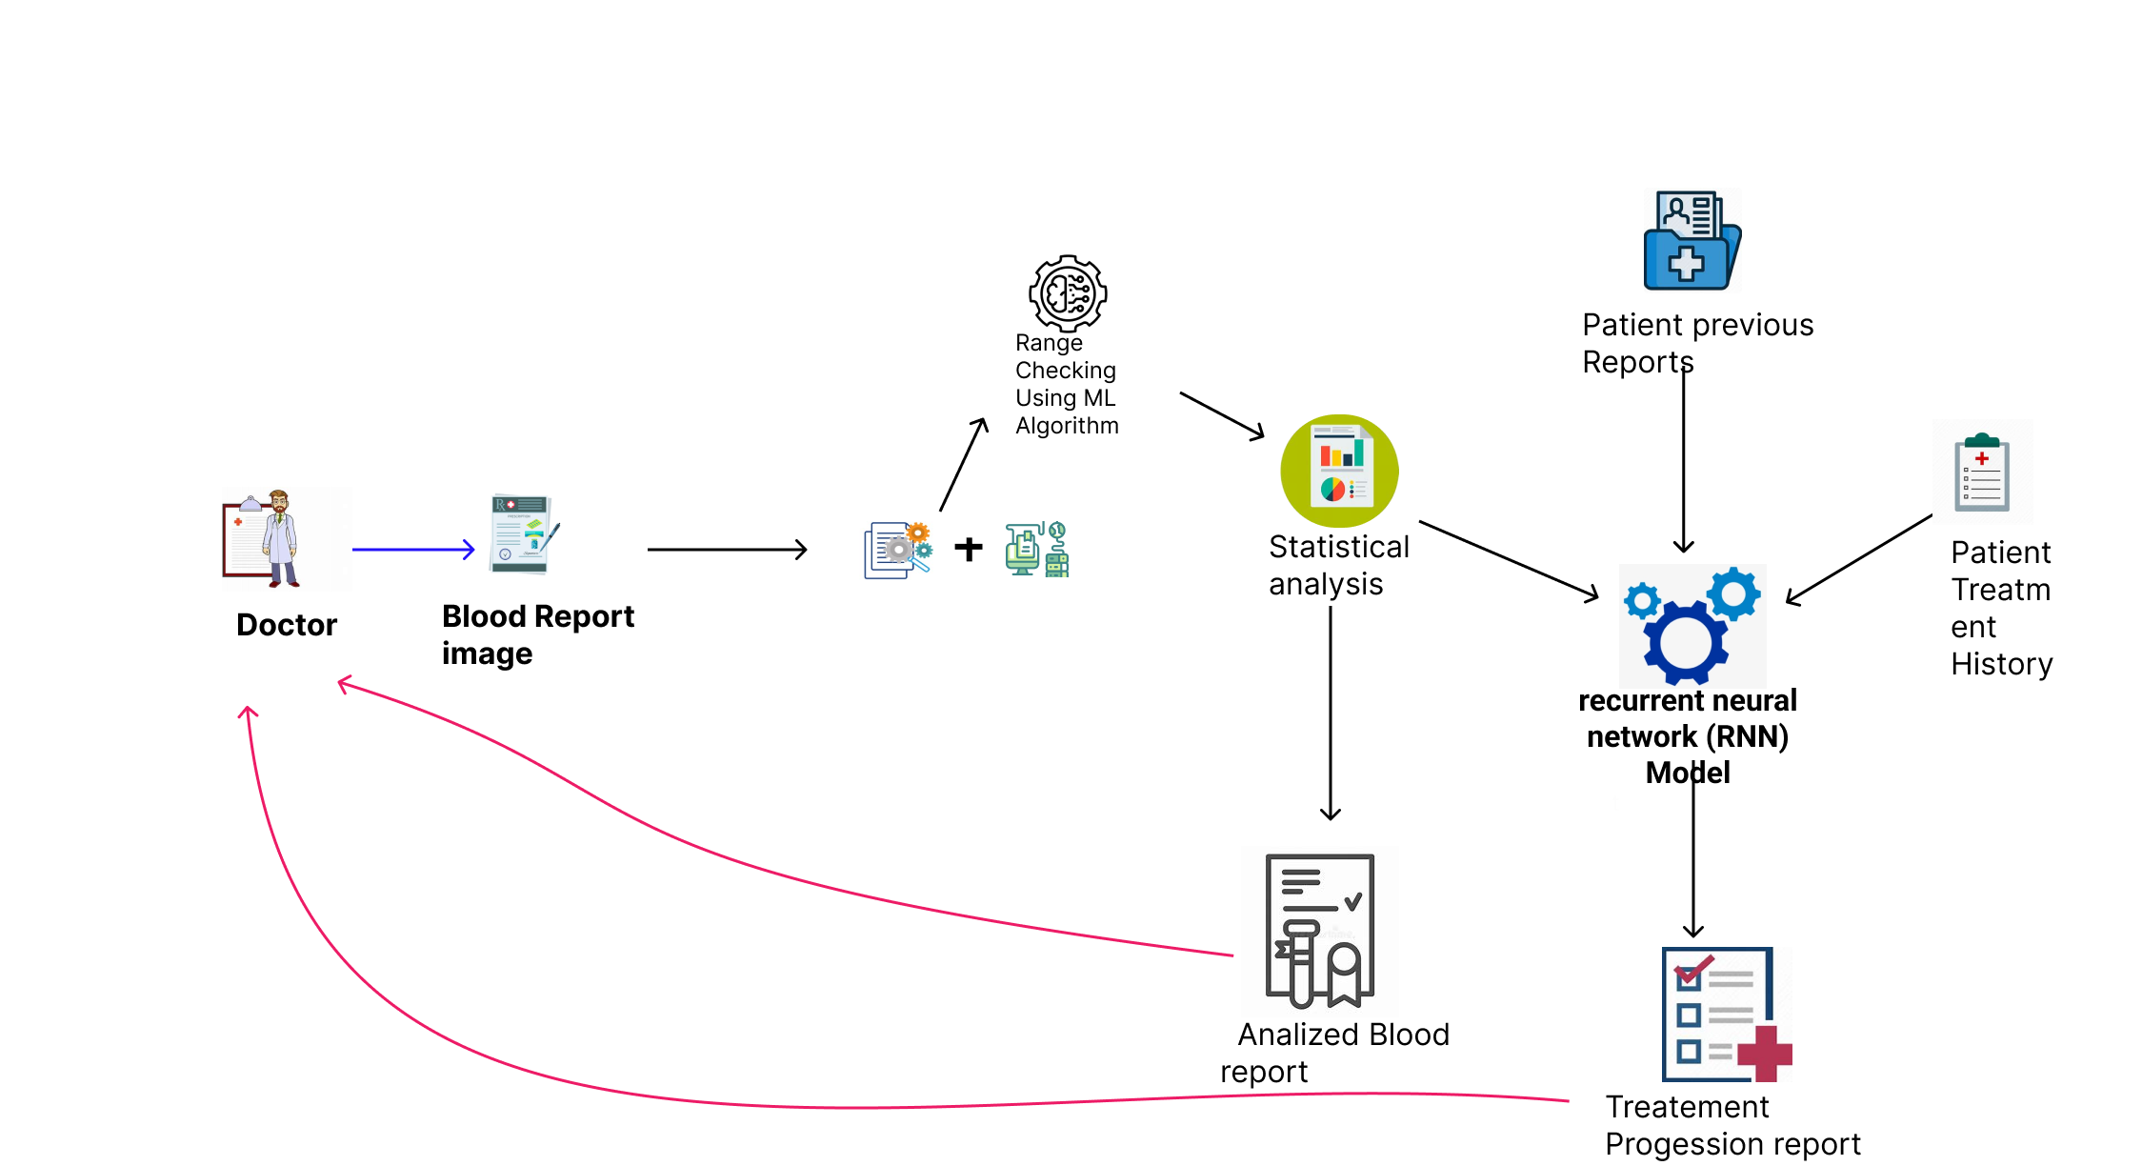
System Diagram
IT19955582 | Mallawaarachchi T.S | Project ID : 22_23-J-73

Slide 31
Tools and Technologies
Technologies
Techniques
Node JS
AWS
Google Collabs
React Native
Visual Studio IDE
Firebase
Data Preparation
Feature Extraction
Natural Language Processing (NLP)
Data Preprocessing
IT19955582 | Mallawaarachchi T.S | Project ID : 22_23-J-73

Slide 32
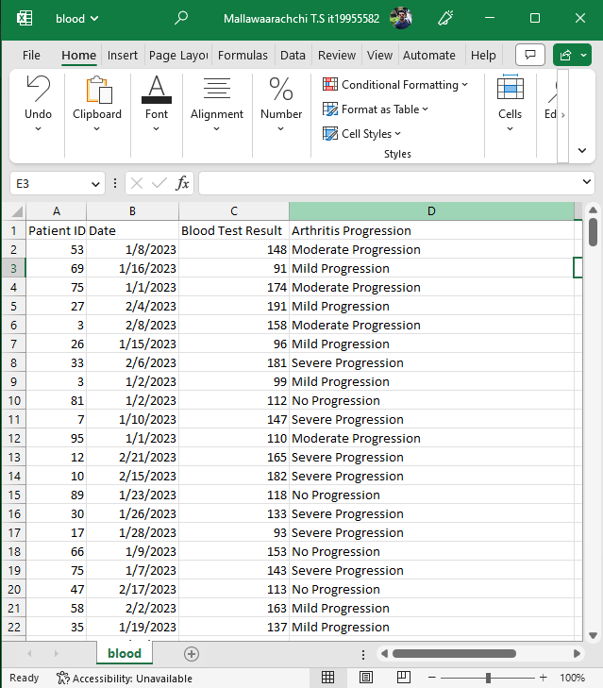
Dataset
Source:-
We collect data from Patients , Ayurvedic clinics
Method:-
Survey and field visit
IT19955582 | Mallawaarachchi T.S | Project ID : 22_23-J-73

Slide 33

Current Progress – 50%
Data Collection and Collecting relevant blood test data of arthritic patients including blood cell count, ESR
50%
Data Preprocessing and Build the LSTEM model and
Model Validation
Make predictions about the progression of Treatments
IT19955582 | Mallawaarachchi T.S | Project ID : 22_23-J-73

Slide 34
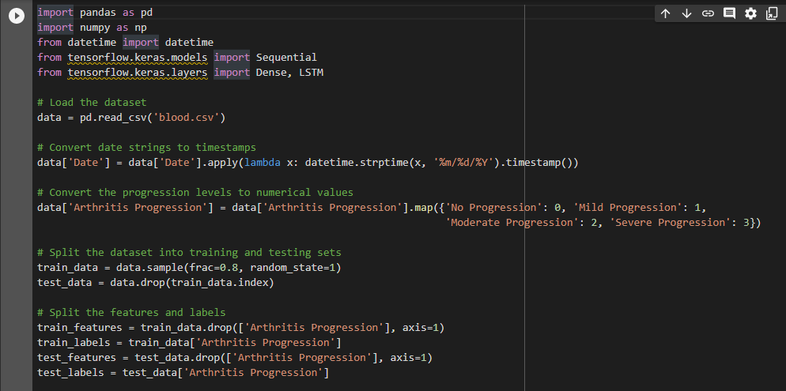
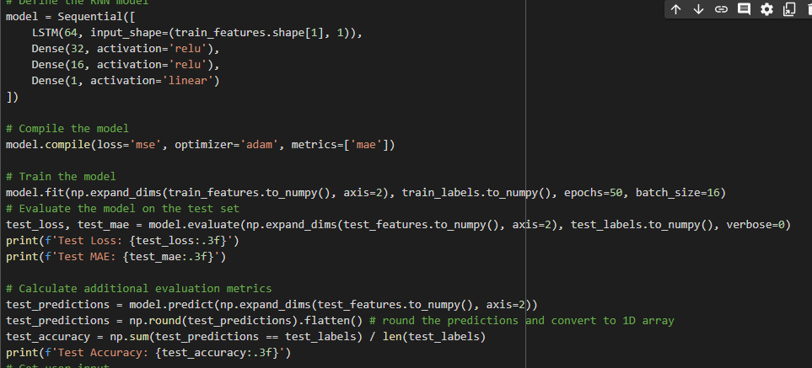
Evidence of the project
IT19955582 | Mallawaarachchi T.S | Project ID : 22_23-J-73

Slide 35
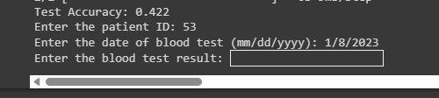
Evidence of the project
IT19955582 | Mallawaarachchi T.S | Project ID : 22_23-J-73

Slide 36
Next expected Progress – 100%
Collect the Blood report Data , including blood cell count, ESR, CRP, RF, ANA, CCP, and other relevant biomarkers to improve algorithm accuracy
50%
Image processing and feature extraction from blood report
IT19955582 | Mallawaarachchi T.S | Project ID : 22_23-J-73

Slide 37
Ayurvedic Treatment
Recommendation
Samaranayaka S.W | IT19955414
B.Sc. (Hons) Degree in Information Technology Specialization in Information Technology

Slide 38
Introduction
Integrating traditional knowledge of Ayurvedic medicine with advanced technology has the potential to provide personalized treatment recommendations for arthritis patients.
This integration can help provide more effectiveness and efficiency in the treatment of arthritis, helping to improve patient's quality of life and overall well-being.
Ayurvedic treatment for arthritis is to reduce inflammation and pain, improve joint mobility, and prevent further damage to the joints. It may include a combination of dietary changes, herbal remedies, and lifestyle modifications.
Incorporating a combination of knowledge-based systems and machine learning algorithms could be considered.
IT19955414 | Samaranayaka S.W | Project ID : 22_23-J-73

Slide 39
Research Problem
How can traditional knowledge of Ayurvedic medicine be integrated with advanced technology to provide personalized treatment recommendations for arthritis patients?
IT19955454 | Samaranayaka S.W | Project ID : 22_23-J-73

Slide 40
Main and Sub Objectives
Main Objective
To provide personalized treatment recommendations based on the principles of Ayurvedic medicine, taking into account factors such as the patient's age, sex, symptoms, and overall health.
Sub Objectives
Gather data on arthritis and its various treatments
Analyze the patient's data and the Ayurvedic medicine database
Provides personalized treatment recommendations for the patient
IT19955414 | Samaranayaka S.W | Project ID : 22_23-J-73

Slide 41
Research Gap
Features | Development of a ML-Based Model to Predict the Efficacy of Ayurvedic Interventions [1] | An observational study on the effect of Ayurvedic treatment [2] | Anti-RA Arthritis Potential of medical plants [3] | AyuAira (Proposed system)
Analyze the patient’s data | Yes | Yes | Yes | Yes
Use the Machine learning-based models | Yes | Yes | Yes | Yes
Personalized Treatment recommendation | No | No | No | Yes
Long-term follow-up | No | Yes | No | Yes
Analyze the patient's data and provide personalized treatments recommendation for arthritis patients.
IT19955414 | Samaranayaka S.W | Project ID : 22_23-J-73

Slide 42
Methodology
System Diagram
01.System Diagram
Tools and Technology
03. Requirements
IT19955414 | Samaranayaka S.W | Project ID : 22_23-J-73

Slide 43
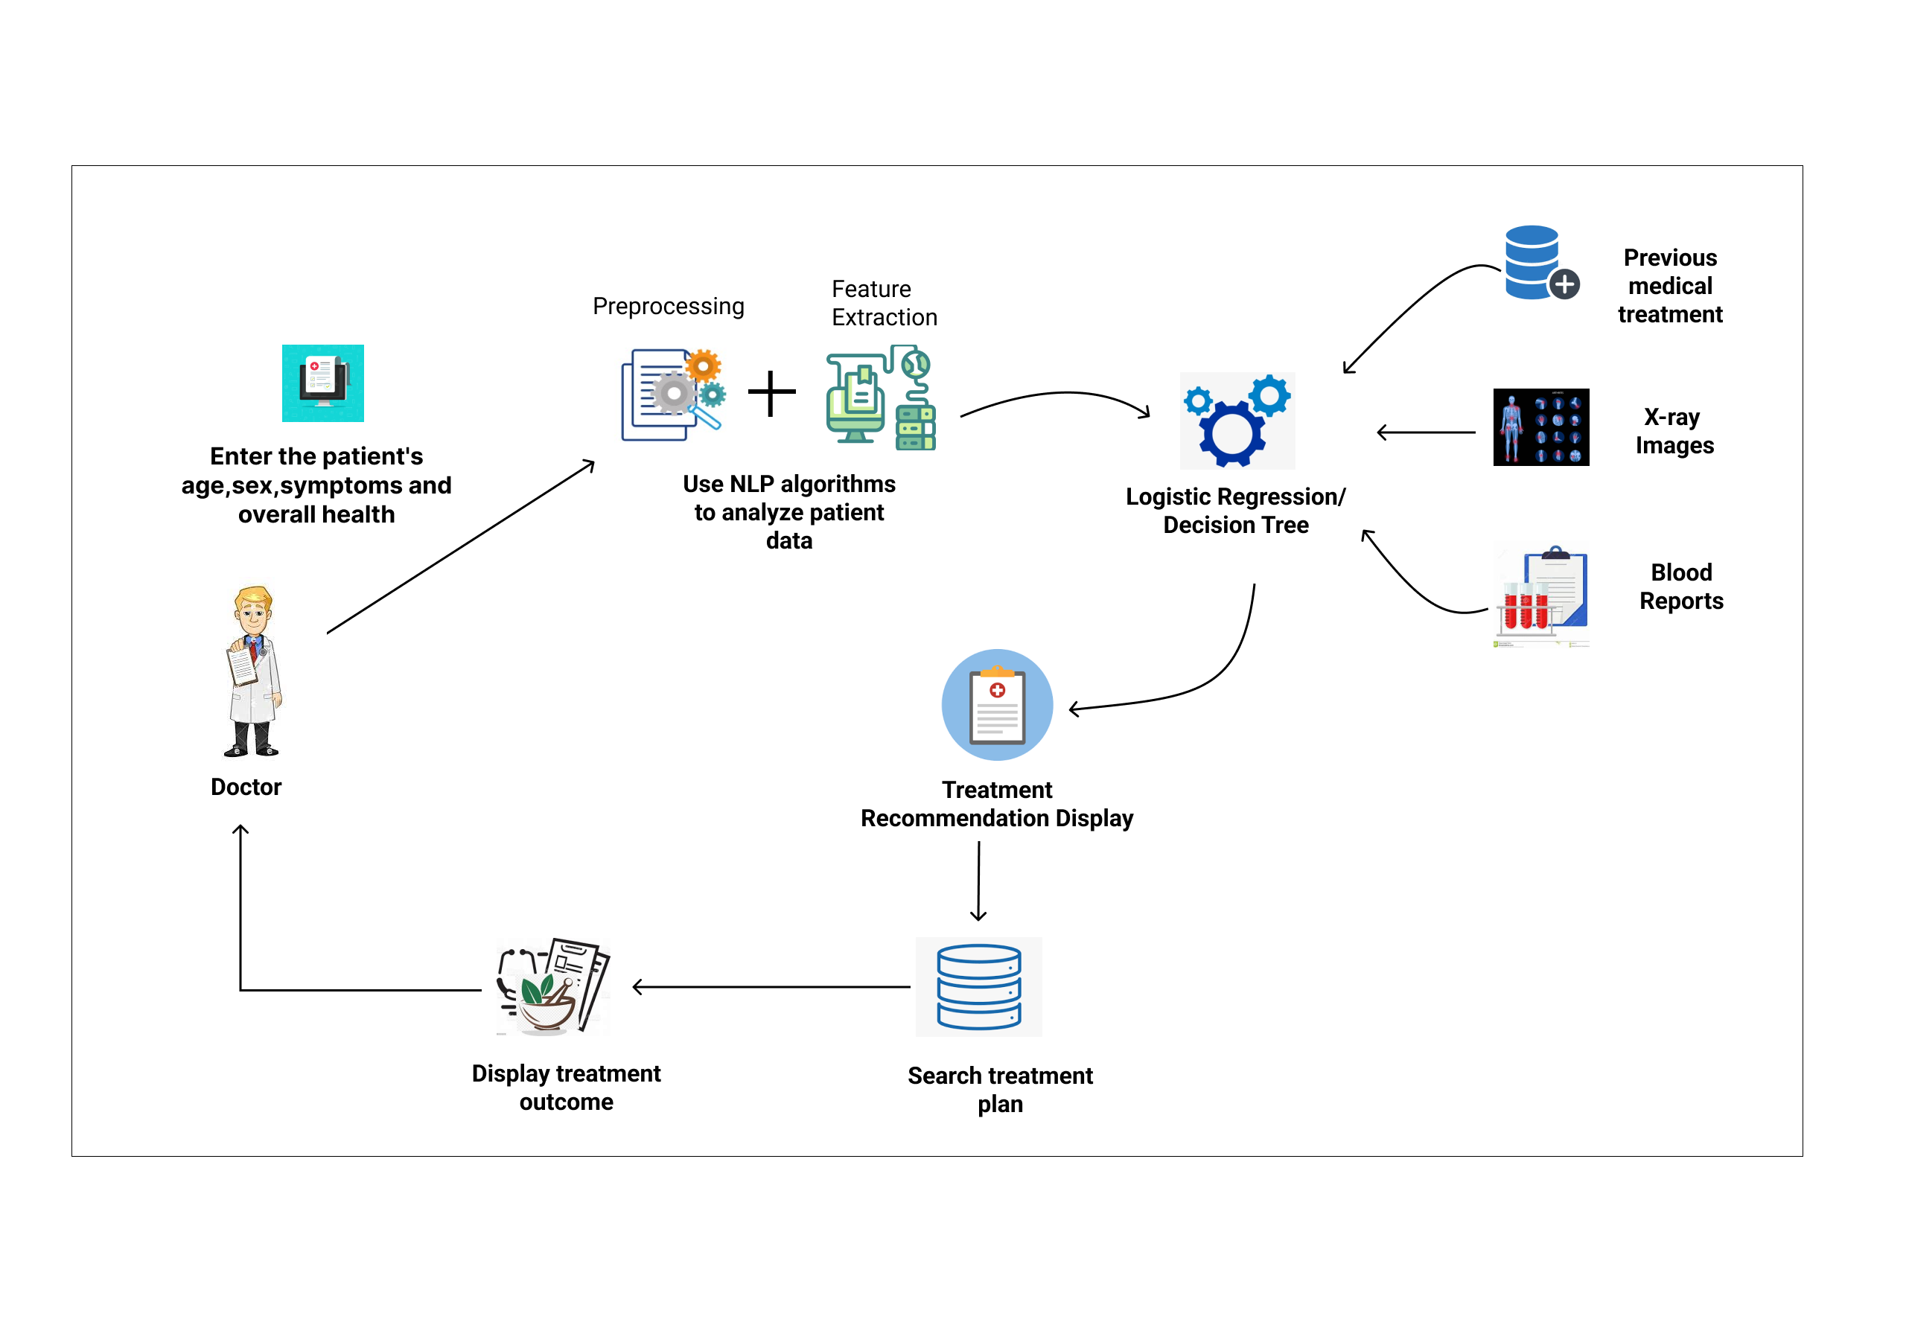
System Diagram
IT19955414 | Samaranayaka S.W | Project ID : 22_23-J-73

Slide 44
Tools and Technologies
Technologies
Techniques
Node JS
AWS
Google Collabs
React Native
Visual Studio IDE
Firebase,
Heroku
Data Preparation
Feature Extraction
Decision Tree Algorithm
IT19955414 | Samaranayaka S.W | Project ID : 22_23-J-73

Slide 45
Novelty of component
Determine the precise location of the disease and provide precise and accurate personalized treatment for that disease.
Here, the patient's age, gender, symptoms, and overall health are used as input. Based on these factors, the system recommends the most specific treatment according to the identified arthritis condition.
Medical
history
Patient’s data
X-ray images
Blood reports
IT19955414 | Samaranayaka S.W | Project ID : 22_23-J-73

Slide 46
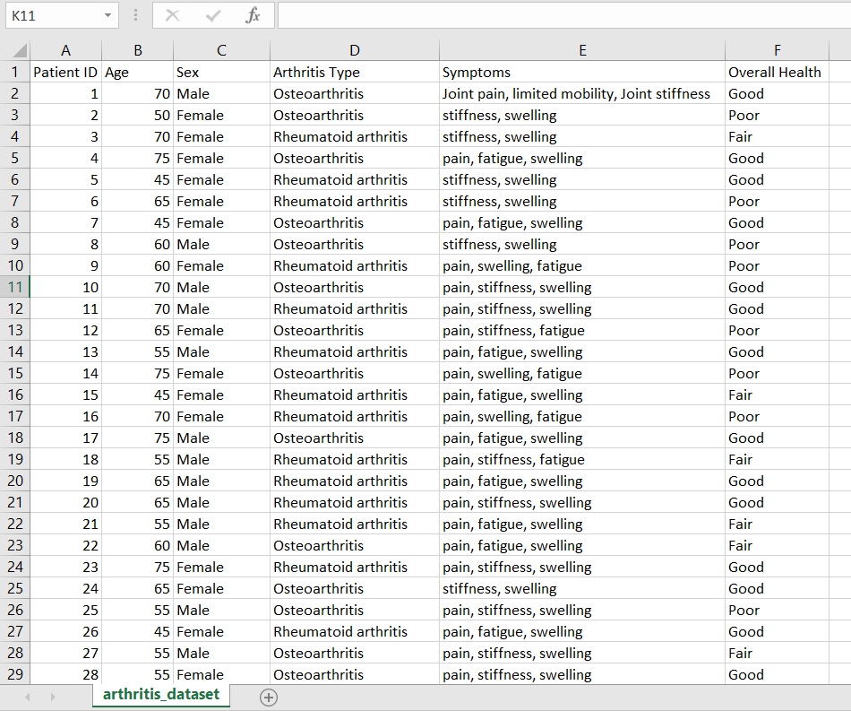
Dataset
Source:
We collected data from the field visit. (Wickramarachchi Ayurvedic University)
IT19955414 | Samaranayaka S.W | Project ID : 22_23-J-73

Slide 47
Current Progress – 50%
50%
Data Collection and Annotate the data as a formal
Train the annotated data and Generate a model to
analyze the patient's data
Identify and provide the best-personalized treatment
recommendation
IT19955414 | Samaranayaka S.W | Project ID : 22_23-J-73

Slide 48
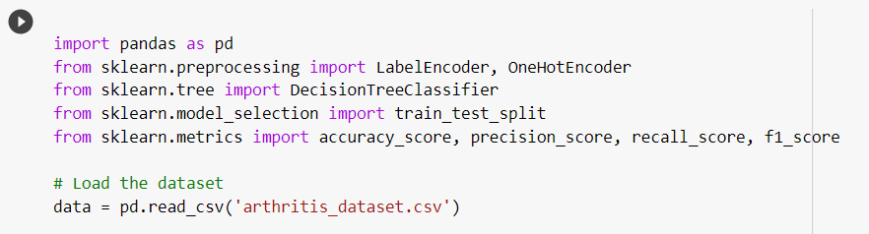
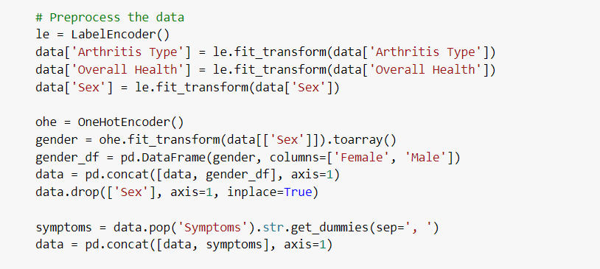
Evidence of the project
Load the dataset
Preprocess the data
IT19955414 | Samaranayaka S.W | Project ID : 22_23-J-73

Slide 49
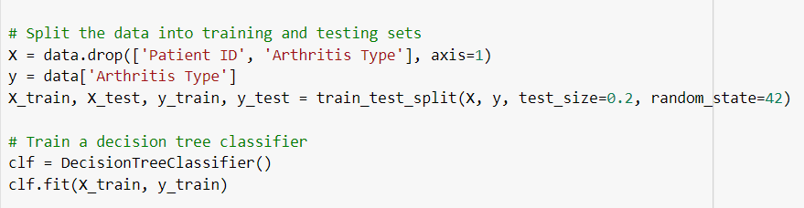
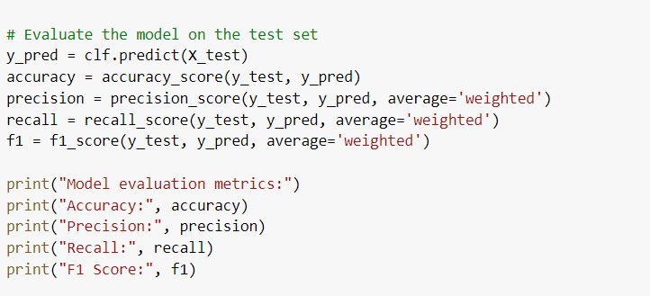
Evidence of the project
Evaluate the model on the test
IT19955414 | Samaranayaka S.W | Project ID : 22_23-J-73

Slide 50
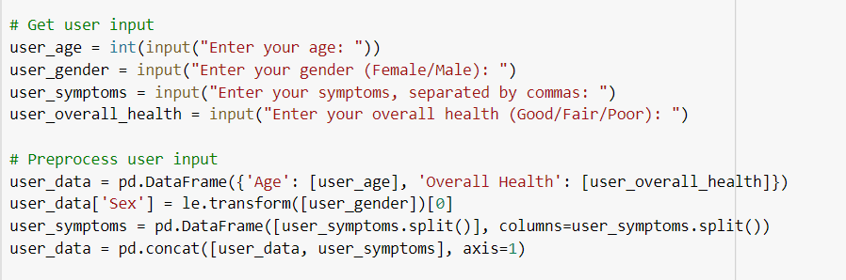
Evidence of the project
Get user input and preprocess
IT19955414 | Samaranayaka S.W | Project ID : 22_23-J-73

Slide 51
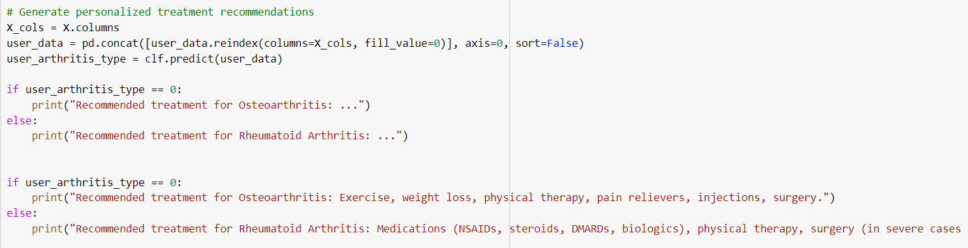
Evidence of the project
Generate personalized treatment
IT19955414 | Samaranayaka S.W | Project ID : 22_23-J-73

Slide 52
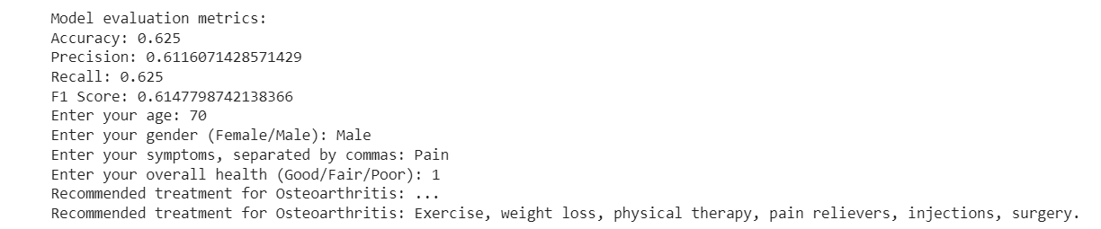
Evidence of the project
Results of Analyzed data
IT19955414 | Samaranayaka S.W | Project ID : 22_23-J-73

Slide 53
Next Expected Progress – 100%
Build a more precise and accurate result by developing the scope
Generating a more specific, personalized treatment based on the identified arthritis condition by integrating features such as a blood report, x-ray images, and medical history
Improve the accuracy of treatment recommendation
Designing and implementing a precise treatment recommendation application
IT19955414 | Samaranayaka S.W | Project ID : 22_23-J-73

Slide 54

Continuous Monitoring and
Feedback.
Jayangika D.H.K.C | IT19146270
B.Sc. (Hons) Degree in Information Technology Specialization in Information Technology

Slide 55
Introduction
Arthritis is a common and chronic disease affecting millions of people worldwide, and it can cause significant pain, inflammation, and joint damage.
Traditional Ayurvedic medicine is a personalized approach to treatment, which requires monitoring the patient's symptoms, treatment progress, and overall health.
Continuous monitoring and feedback are essential in Ayurvedic treatment for arthritis as they allow the practitioner to track the patient's progress and make necessary adjustments to the treatment plan. This ensures that the treatment is effective and customized to the patient's needs.
Based on Ayurvedic concepts, machine learning algorithms develop a prediction model that gives the treating doctor real-time feedback while considering the symptoms of arthritis, the effectiveness of treatment, and overall health.
IT19146270 | Jayangika D.H.K.C | Project ID : 22_23-J-73

Slide 56
Research Question
How can machine learning algorithms be used to continuously monitor the patient's symptoms, treatment progress, and overall health, and provide real-time feedback?
IT19146270 | Jayangika D.H.K.C | Project ID : 22_23-J-73

Slide 57
Objective
Specific Objective
To continuously monitor the patient's symptoms, treatment progress, and overall health, and provide feedback to the treating doctor.
Sub Objective
Analyze the x-ray report ,blood report and treatment progress
Monitor the arthritis patient's symptoms, treatment progress, and overall health
Providing Real time Feedback
IT19146270 | Jayangika D.H.K.C | Project ID : 22_23-J-73

Slide 58
Novelty of component
Using machine learning algorithms to continuously monitor the patient’s condition and provide real-time feedback.
The change in the patient's arthritis condition can be monitored in real time.
Continuous monitoring and feedback allow the practitioner to customize the treatment plan based on the patient's specific needs, leading to more effective treatment.
Traditional medicine has not yet developed a system for monitoring arthritis continuously.
IT19146270 | Jayangika D.H.K.C | Project ID : 22_23-J-73

Slide 59
Research Gap
Features | Patients' Satisfaction with the Ayurvedic Treatment: | Long-Term Effects of Ayurvedic Treatment in Rheumatoid Arthritis | Effectiveness of Ayurvedic Interventions in the Management of Knee Osteoarthritis | Role of Telemedicine and Ayurveda in the Management of Rheumatoid Arthritis | AyuAIra
Analyze the x-ray report ,blood report and treatment progress | No | No | No | No | Yes
Monitor the arthritis patient's symptoms, treatment progress, and overall health | No | No | Yes | No | Yes
long-term continuous real time monitoring | No | Yes | No | No | Yes
Real Time Feedback | No | No | No | Yes | Yes
IT19146270 | Jayangika D.H.K.C | Project ID : 22_23-J-73

Slide 60
Methodology
System Diagram
01.System Diagram
Tools and Technology
03. Requirements
IT19146270 | Jayangika D.H.K.C | Project ID : 22_23-J-73

Slide 61
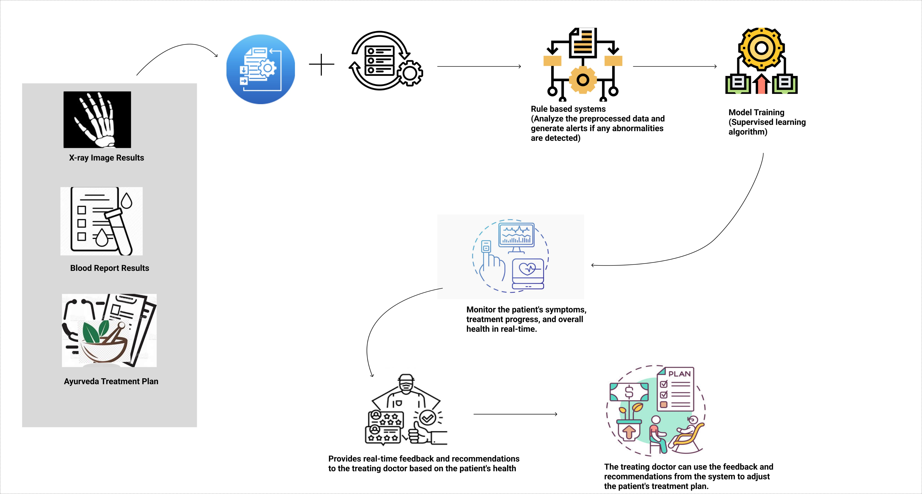
System Diagram
IT19146270 | Jayangika D.H.K.C | Project ID : 22_23-J-73

Slide 62
Tools and Technologies
Technologies
Techniques
Node JS
AWS
Google Collabs
React Native
Tensor flow
Firebase
Data Preprocessing
Feature Extraction
Neural network
IT19146270 | Jayangika D.H.K.C | Project ID : 22_23-J-73

Slide 63
Current Progress – 50%
Collect real-time datasets on arthritis patients' symptoms, treatment progress.
50%
Tested the accuracy of trained model
According to the patient's arthritis symptoms, providing accurate feedback.
IT19146270 | Jayangika D.H.K.C | Project ID : 22_23-J-73

Slide 64
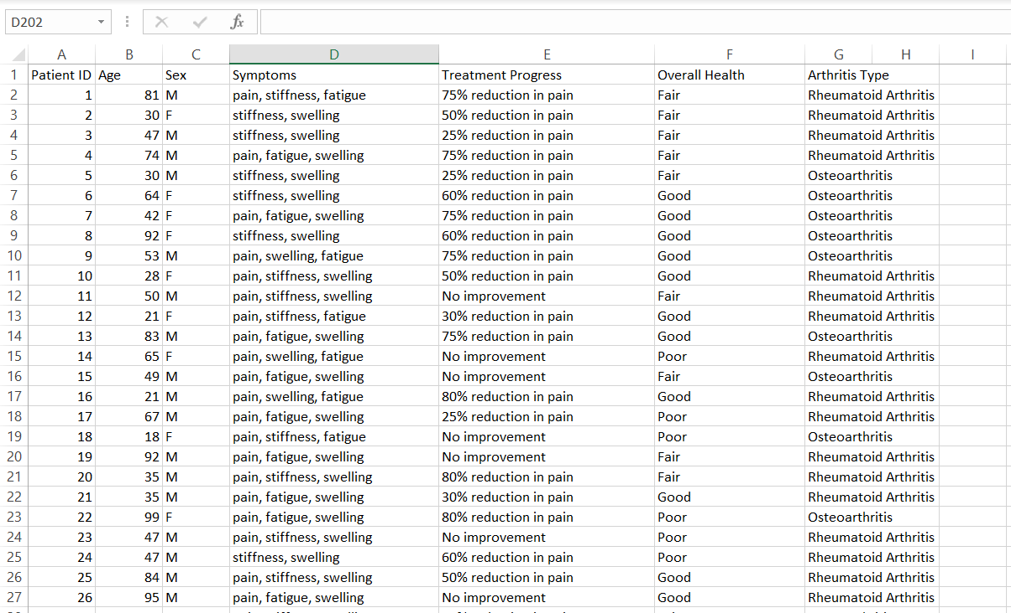
Dataset
Source:
We collected data from the field visit. (Wickramarachchi Ayurvedic University)
IT19146270 | Jayangika D.H.K.C | Project ID : 22_23-J-73

Slide 65
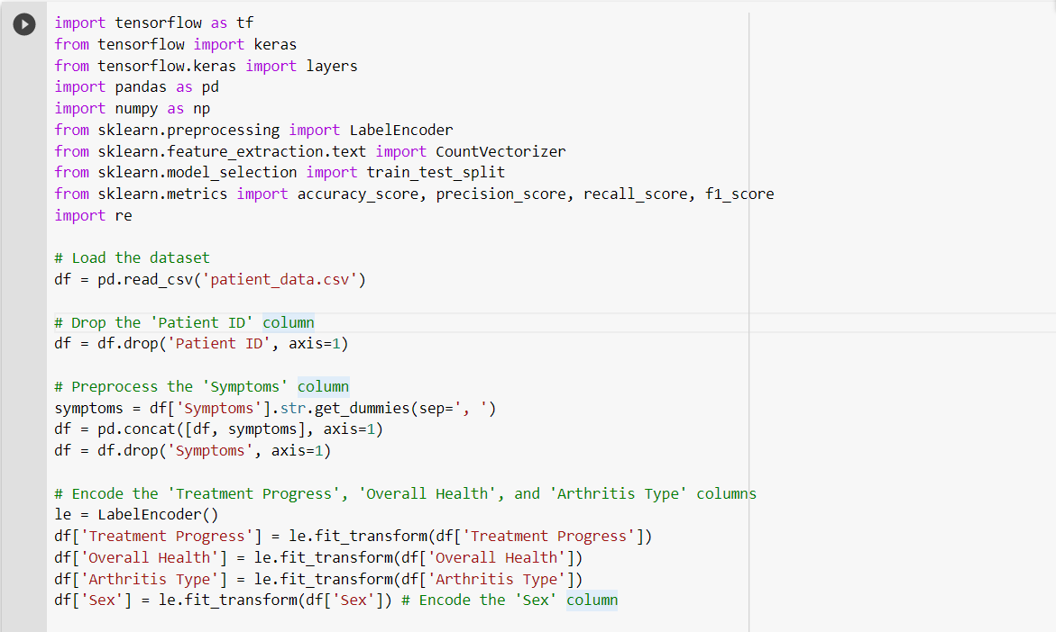
Evidence of the project
IT19146270 | Jayangika D.H.K.C | Project ID : 22_23-J-73

Slide 66
Evidence of the project
IT19146270 | Jayangika D.H.K.C | Project ID : 22_23-J-73

Slide 67
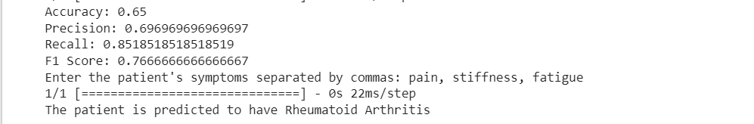
Evidence of the project
IT19146270 | Jayangika D.H.K.C | Project ID : 22_23-J-73

Slide 68
Next expected Progress – 100%
Improve data collection more efficient to increase the quantity of feedbacks.
Providing feedback by using an alert to show changes in the patient's level of arthritis.
Designing and implementing the application.
Improve the accuracy of Continuous monitoring and feedback.
IT19146270 | Jayangika D.H.K.C | Project ID : 22_23-J-73

Slide 69

Risk Mitigation

Slide 70
Risk Mitigation
Completed the work according to a time plan.
Upload the code into GitLab.
Stored the data in Google drive as a backup.
Execute work according to the MS Planner.

Slide 71
Commercialization

Slide 72
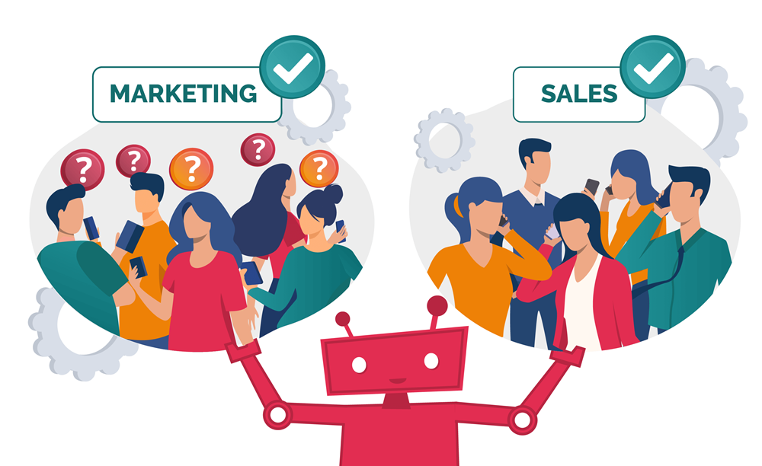
Marketing Strategies
Targeted Audience:
Ayurvedic Doctors
Promoting Methods:
Social media campaign
Industry Conferences

Slide 73
Marketing Strategies
Business Plan:
Give a one-month trial for ayurvedic doctors.
Get feedback from the ayurvedic doctors and make necessary changes.
Marketing Plan:
Create a prototype and give it to the doctors.
Create a plan for social media and email marketing.

Slide 74
THANK YOU!

